Slide 1
Foundations of Data Science & Analytics DSCI 633, Fall 2021
Lecture 3
Nidhi Rastogi
Assistant Professor, GCCIS, RIT
August 31, 2021

Slide 2
Course Information
GitHub link - https://github.com/aiforsec/RIT-DSCI-633-FDS
TA – Rigved Rakshit, GitHub- rigved
Assignment 2 will be assigned in next class
Tools used in the Course Slide added

Slide 3
Lecture Objective
Types of ML models
Linear models
How to
study data
select a model
train a model
make predictions using the model

Slide 4
Tools Needed in the Course
We will be using production-ready Python frameworks:
Sci-kit-Learn
Implements many ML algorithms efficiently
Created by David Cournapeau in 2007
Now led by a team of researchers at the French Institute for Research in Computer Science and Automation (INRIA).
TensorFlow
Complex library for distributed numerical computation
Makes possible to train and run very large NN efficiently by distributing the computations across potentially hundreds of multi-GPU (graphics processing unit) servers.
Created at Google and supports many of its large-scale Machine Learning applications.
Open sourced in 10/2015. V2.0 released in 09/ 2019.
Keras
High-level Deep Learning API
Can run on top of either TensorFlow, Theano, or Microsoft Cognitive Toolkit (formerly known as CNTK).
TensorFlow comes with its own implementation of this API, called tf.keras, which provides support for some advanced TensorFlow features (e.g., the ability to efficiently load data).

Slide 5
Types of Machine Learning Systems
Whether or not they are trained with human supervision (Supervised, Unsupervised, Semi-supervised, and Reinforcement Learning)
Whether or not they can learn incrementally on the fly (online versus batch learning)
Whether they work by simply comparing new data points to known data points, or instead detect patterns in the training data and build a predictive model, much like scientists do (instance-based versus model-based learning).

Slide 6
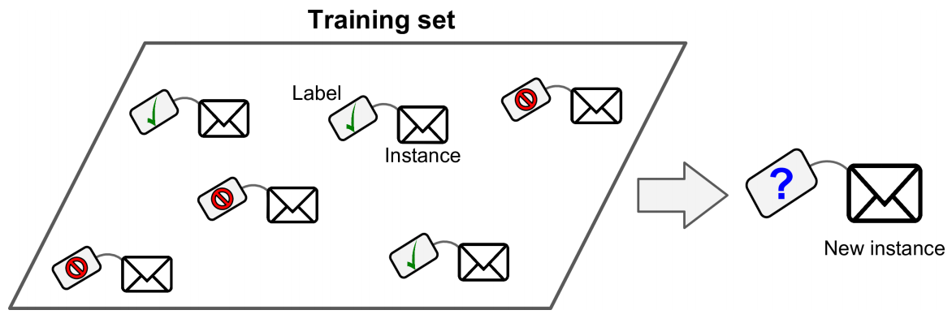
Supervised Learning
Classification
Trained with many example emails along with their class (spam or ham)
It must learn how to classify new emails
Notes:
In supervised learning, the training data you feed to the algorithm includes the desired solutions, called labels

Slide 7
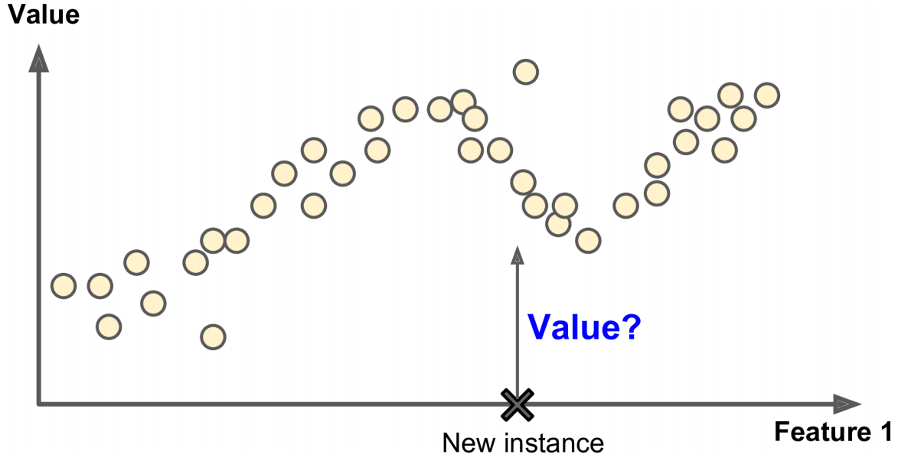
Supervised Learning
Regression
Predict target numeric value price of a car, given a set of features (mileage, age, brand, etc.) called predictors.
Some regression algorithms can be used for classification as well
Logistic Regression: can output a value that corresponds to the probability of belonging to a given class
e.g., 20% chance of being spam

Slide 8
Supervised Learning we will study
Linear Regression
Logistic Regression
k-Nearest Neighbors
Support Vector Machines (SVMs)
Decision Trees and Random Forests
Neural networks

Slide 9
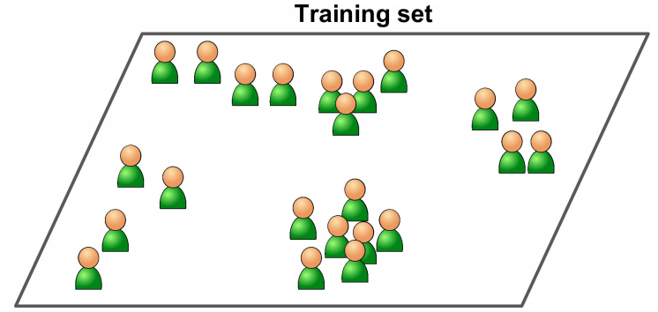
Unsupervised Learning
Learn without a teacher
Clustering
K-Means, DBSCAN, Hierarchical Cluster Analysis (HCA)
Anomaly detection and novelty detection
One-class SVM, Isolation Forest
Visualization and dimensionality reduction
Principal Component Analysis (PCA), Kernel PCA, Locally-Linear Embedding (LLE), t-distributed Stochastic Neighbor Embedding (t-SNE)
Association rule learning
Apriori, Eclat

Slide 10
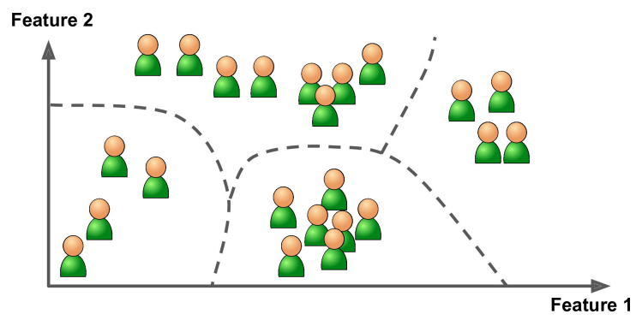
Clustering
run a clustering algo
to detect groups of similar visitors

Slide 11
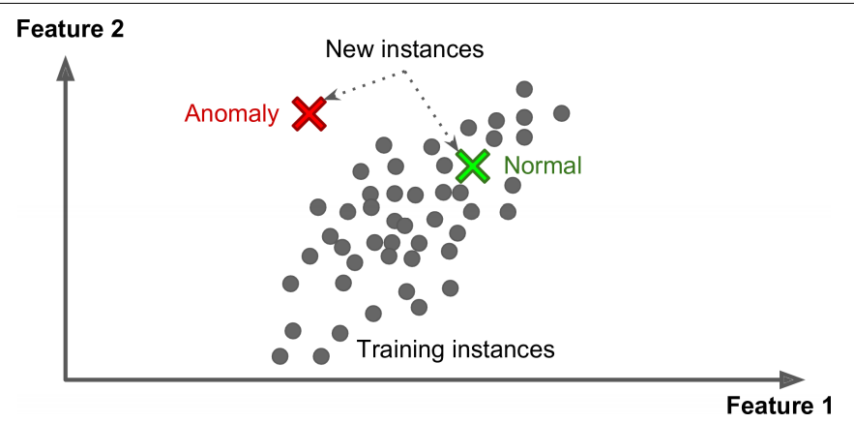
Anomaly Detection
Input: System is shown mostly normal instances during training
Model: learns to recognize normal.
Therefore, can tell whether a new instance looks like a normal one or whether it is likely an anomaly
Examples:
Detecting unusual credit card transactions to prevent fraud
Catching manufacturing defects
Automatically removing outliers from a dataset before feeding it to another learning algorithm

Slide 12
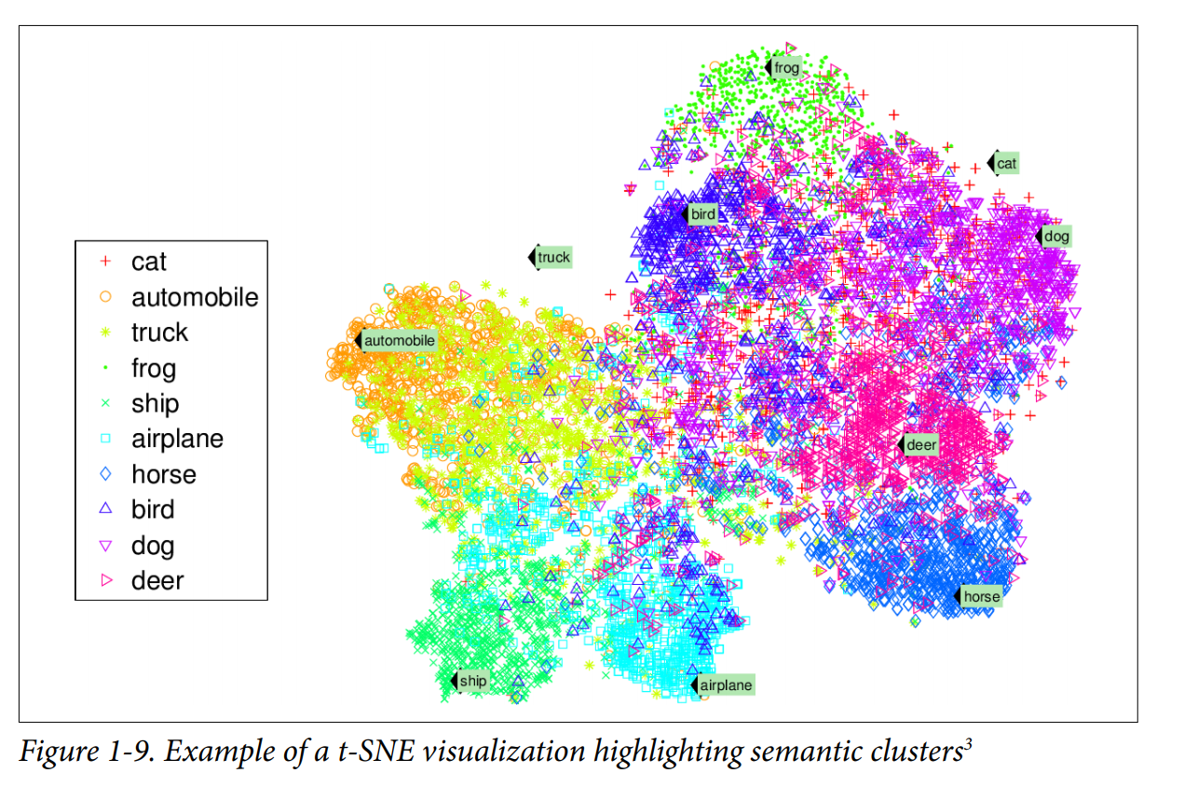
Visualization
Input : lot of complex and unlabeled data,
Output : 2D or 3D representation of your data, easily plottable
Keep separate clusters in the input space from overlapping in the visualization
Related Concept
A related task is dimensionality reduction
goal is to simplify the data without losing too much information.

Slide 13
Association Rules
- Dig into large amounts of data and discover interesting relations between
attributes.
Example, suppose you own a supermarket
Running an association rule on your sales logs may reveal that people who purchase barbecue sauce and potato chips also tend to buy steak. Thus, you may want to place these items close to each other.

Slide 14
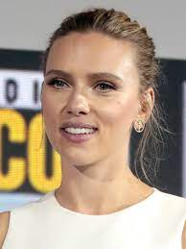

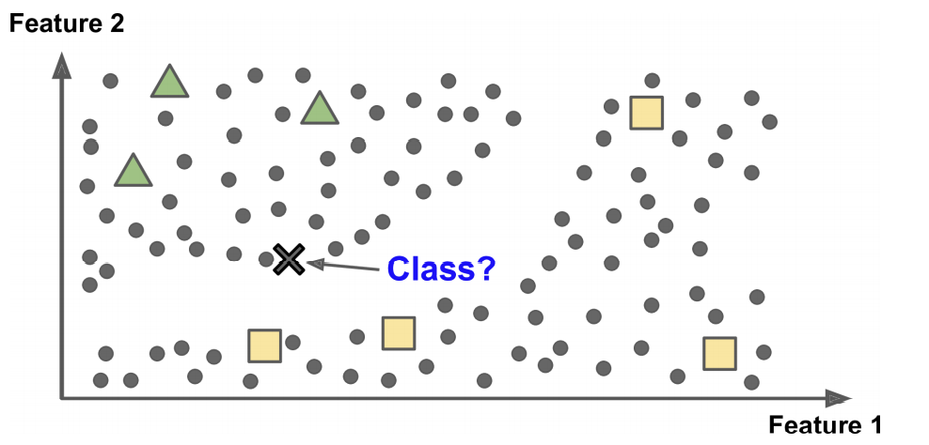
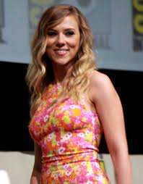

Semi supervised Learning
Algorithms can deal with partially labeled training data
Example - Google Photos
automatically recognizes person A, B
1 label per person.
It will name everyone in every photo
useful for searching photos
This is the unsupervised part of the algorithm

Slide 15
Semi-supervised Learning
Most of them are combinations of unsupervised and supervised algorithms
Deep Belief Networks (DBNs)
Unsupervised components: Restricted Boltzmann Machines (RBMs) stacked on top of one another.
RBMs are trained sequentially in an unsupervised manner
Whole system is then fine-tuned using supervised learning techniques

Slide 16
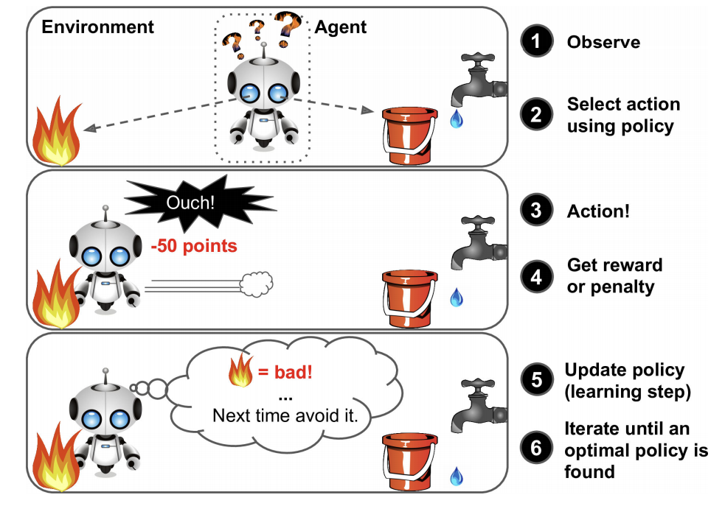
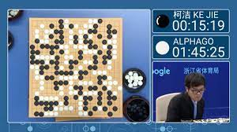
Reinforcement Learning
Agent : the learning system
Observe the environment
Select and perform actions
Rewarded or Penalized
Self-learning, called policy,
Goal: to get the most reward over time
Example- DeepMind’s AlphaGo program
made headlines in May 2017
beat Go world champion Ke Jie
Learned its winning policy
by analyzing millions of games
playing many games against itself

Slide 17
Batch and Online Learning
Batch learning
System trained using all the available data
Takes a lot of time and computing resources (CPU, memory space, disk space, disk I/O, network I/O, etc.)
$$$$
typically done offline.
System is trained -> launched into production -> runs without learning anymore
For new learning (such as a new type of spam)
train a new version of system from scratch on the full dataset (old and new)
replace system with new one
Examples… ?
If your system needs to adapt to rapidly changing data (e.g., to pre‐ dict stock prices), then you need a more reactive solution

Slide 18
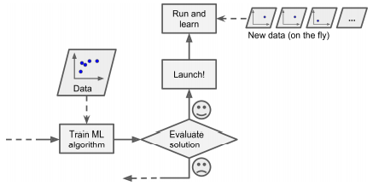
Batch and Online Learning
Online learning
Train system incrementally – feed data instances sequentially (individually or by small groups called mini-batches)
Learning is on-the-fly
Great for systems that receive data as a continuous flow
and need to adapt to change rapidly or autonomously
Example - ?
Good option limited computing resources – once learning done, instances not needed
Used to train systems on huge datasets that cannot fit in one machine’s main memory
online learning

Slide 19
Batch and Online Learning
Learning Rate – Speed at which system should adapt to changing data.
high learning rate – system adapts fast to new data
Forgets quickly too!!!
low learning rate – high system inertia, learn more slowly
but less sensitive to noise in the new data or to sequences of nonrepresentative data points (outliers).
Constant monitoring is required to prevent learning from bad data.
Adversarial learning – An ML technique that attempts to fool models by supplying deceptive input.
Most common reason is to cause a malfunction in a machine learning model. [Wikipedia]
System performance will decline gradually
Worse in live systems
Example : Malfunctioning sensor on a robot
online learning

Slide 20
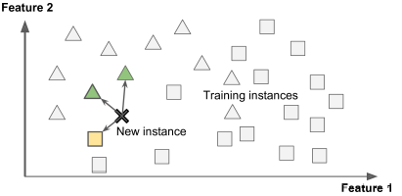
Instance- and Model-based Learning
Instance-based: Learns by example
Such as spam filter programmed to flag emails similar to known spam emails
Measure of similarity between two emails
A VERY basic similarity measure between two emails
# common words

Slide 21
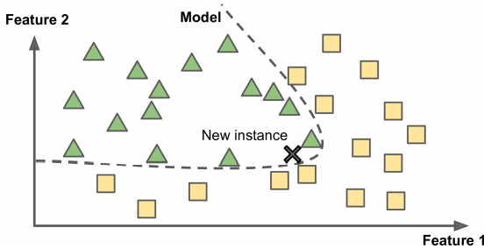
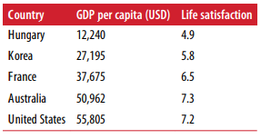
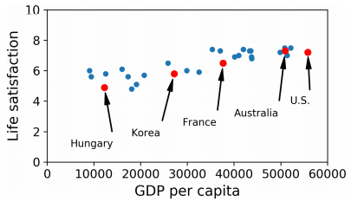
Instance- and Model-based Learning
Model-based: generalize from a set of examples. Build a model of these examples, then use that model to make predictions.
Example: Does money makes people happy?
Download
“Better Life Index” data from the OECD’s website
GDP per capita from the IMF’s website.
Plot the data for a few random countries
Model Selection – Linear Model

Slide 22
Simple Linear Model
life_satisfaction = θ₀ ₊ θ₁ x GDP_per_capita
two model parameters, θ₀ and θ₁; tweaking them to make your model represent any linear function.
Before you use your linear model, you need to define the parameter values of θ₀ and θ_{1.}
those that make your model perform best
Utility Function – measures how good your model is
Cost Function – measures how bad your model is

Slide 23
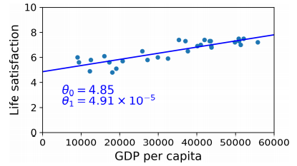
Linear Regression Model
Cost Function : measures the distance between the linear model’s predictions and the training examples; the objective is to minimize this distance.
Model Training: Input your training data to a LR model, and it will find the parameters that make the model fit best to your data.
In the figure, model fits the training data closely
Linear model that fits the training data best

Slide 24
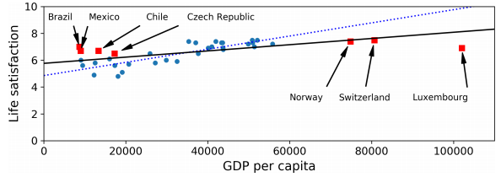
Challenges in ML
Insufficient quantity of training data
Nonrepresentative Training Data – Can make inaccurate predictions
Sampling Noise – sample data too small
Sampling Bias – sample data lare but non-representative. Due to flawed sampling method

Slide 25
Challenges in ML contd…
Poor Quality Data
Irrelevant Features
Overfitting Training Data
Underfitting Training data
Data Mismatch

Slide 26
Testing and Validating
Only way to know how well a model will generalize
Split data into 2 sets (usually 80:20)
Training Set
Testing Set
Generalization Error – error rate on new cases (also called out-of-sample error)
Arrive at it by evaluating model on test data
Compare training error with Generalization error - If the training error is low (i.e., your model makes few mistakes on the training set) but the generalization error is high, it means that your model is overfitting the training data.

Slide 27
Build a model - 1
Housing prices in CA
Data : CA census data, it has metrics such as population, median income, median housing price, and so on for each block group in California
Goal: Predict median housing price in any district, given all the other metrics.
What should you do next?

Slide 28
Build a model - 2
Frame the Problem

Slide 29
Build a model - 2
Frame the Problem.
What is the current solution?

Slide 30
Build a model - 2
Frame the Problem.
What is the current solution?
Start designing your system –
Is it supervised, unsupervised, or reinforcement learning?
Is it a classification, regression or some other task?
Should you use batch or online learning?
Lets Discuss

Slide 31
Build a model - 2
One approach
Supervised learning task - since you are given labeled training examples (each instance comes with the expected output, i.e., the district’s median housing price)
Regression task, since you are asked to predict a value.
More specifically, this is a multiple regression problem since the system will use multiple features to make a prediction (it will use the district’s population, the median income, etc.).
It is also a univariate regression problem since we are only trying to predict a single value for each district.
No continuous flow of data coming in the system, there is no particular need to adjust to changing data rapidly, and the data is small enough to fit in memory, so plain batch learning should do just fine.

Slide 32
Build a model - 2
Frame the Problem.
What is the current solution?
Start designing your system –
Is it supervised, unsupervised, or reinforcement learning?
Is it a classification, regression or some other task?
Should you use batch or online learning?
Select a Model Performance measure

Slide 33
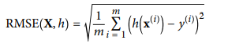
Build a model - 2
Select a Model Performance measure
Root mean square error (RMSE) – gives you an idea of how much error a system typically makes in its predictions
Higher weight for large errors
where, m is the number of instances in the dataset you’re measuring the RMSE on,
x^{(i)} is a vector of all the feature values (excluding the label) of the i^{th} instance in the dataset, and y^{(i)} is its label (the desired output value for that instance).
X is a matrix containing all the feature values (excluding labels) of all instances in the dataset. There is one row per instance and the i^{th} row is equal to the transpose of x^{(i)}, noted (x^{(i)})^{T.4}

Slide 34
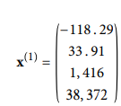
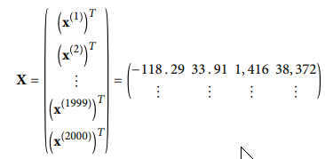
Build a model - 2
where, m is the number of instances in the dataset you’re measuring the RMSE on.
Features – latitude, longitude, #inhabitants, median income, median house $$
x^{(i)} is a vector of all the feature values (excluding the label) of the i^{th} instance in the dataset, and y^{(i)} is its label (the desired output value for that instance).
X is a matrix containing all the feature values (excluding labels) of all instances in the dataset. There is one row per instance and the i^{th} row is equal to the transpose of x^{(i)}, noted (x^{(i)})^{T.4}

Slide 35
Build a model - 2
h is your system’s prediction function, also called a hypothesis. When your system is given an instance’s feature vector x^{(i)}, it outputs a predicted value ŷ^{(i)} = h(x^{(i)}) for that instance
If your system predicts that the median housing price in the first district is $158,400, then
ŷ^{(i)} = h(x^{(i)}) => $158,400
Prediction rate: ŷ^{(i)} -y^{(i)} = $2,000

Slide 36
Open Floor

Slide 37
Pop Quiz
Submit responses on mycourses
What type of Machine Learning algorithm would you use to allow a robot to walk in various unknown terrains

